Slide 1

Restaurant Management System

Slide 2

Restaurant Management System
Team Members
Pratik Pradhan - PM
Rana Dorje Tamang - BA
Riyan Pradhan
Ayush Pradhanang
Renisha Manandhar

Slide 3

Project Manager -PM
PM – who ?
Tasks and duties
Risk and challenges
What I learnt !

Slide 4
Tasks and Duties
Project Charter form
Basecamp setup , gantt chart and WBS
Project schedule
Meeting schedule and minutes
Attendance
Risk analysis

Slide 5
Risk and Challenges
People management – first experience
Device failure of the development team
Personal problems of the co-workers
Unable to attain meeting

Slide 6
What I learnt !
People management
Different technologies
Understood the working system of the project development
Developed more confidence to work with people
Unity is power

Slide 7

Business Analyst - BA
BA – who ?
Restaurant Management System ?
Goals
Requirements
Accomplishment
Personal development

Slide 8
Goals
System to manage staffs
1
System to manage orders
2
System to manage menu items
3
Order from home
4
Reserve table from home
5

Slide 9
Requirements
Staff management
Menu management
Order management
Diagrams : UML Diagrams
Product backlog and sprint backlog

Slide 10
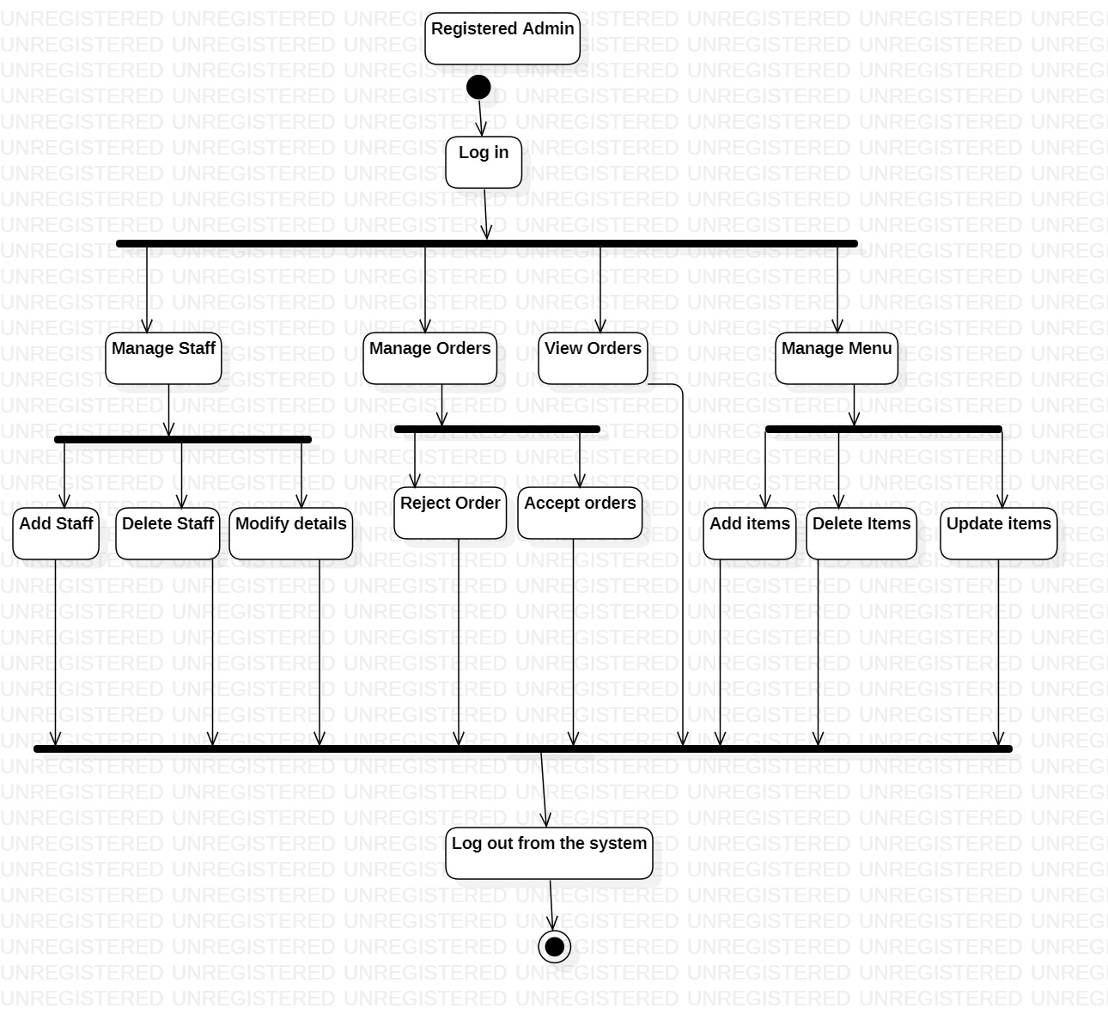
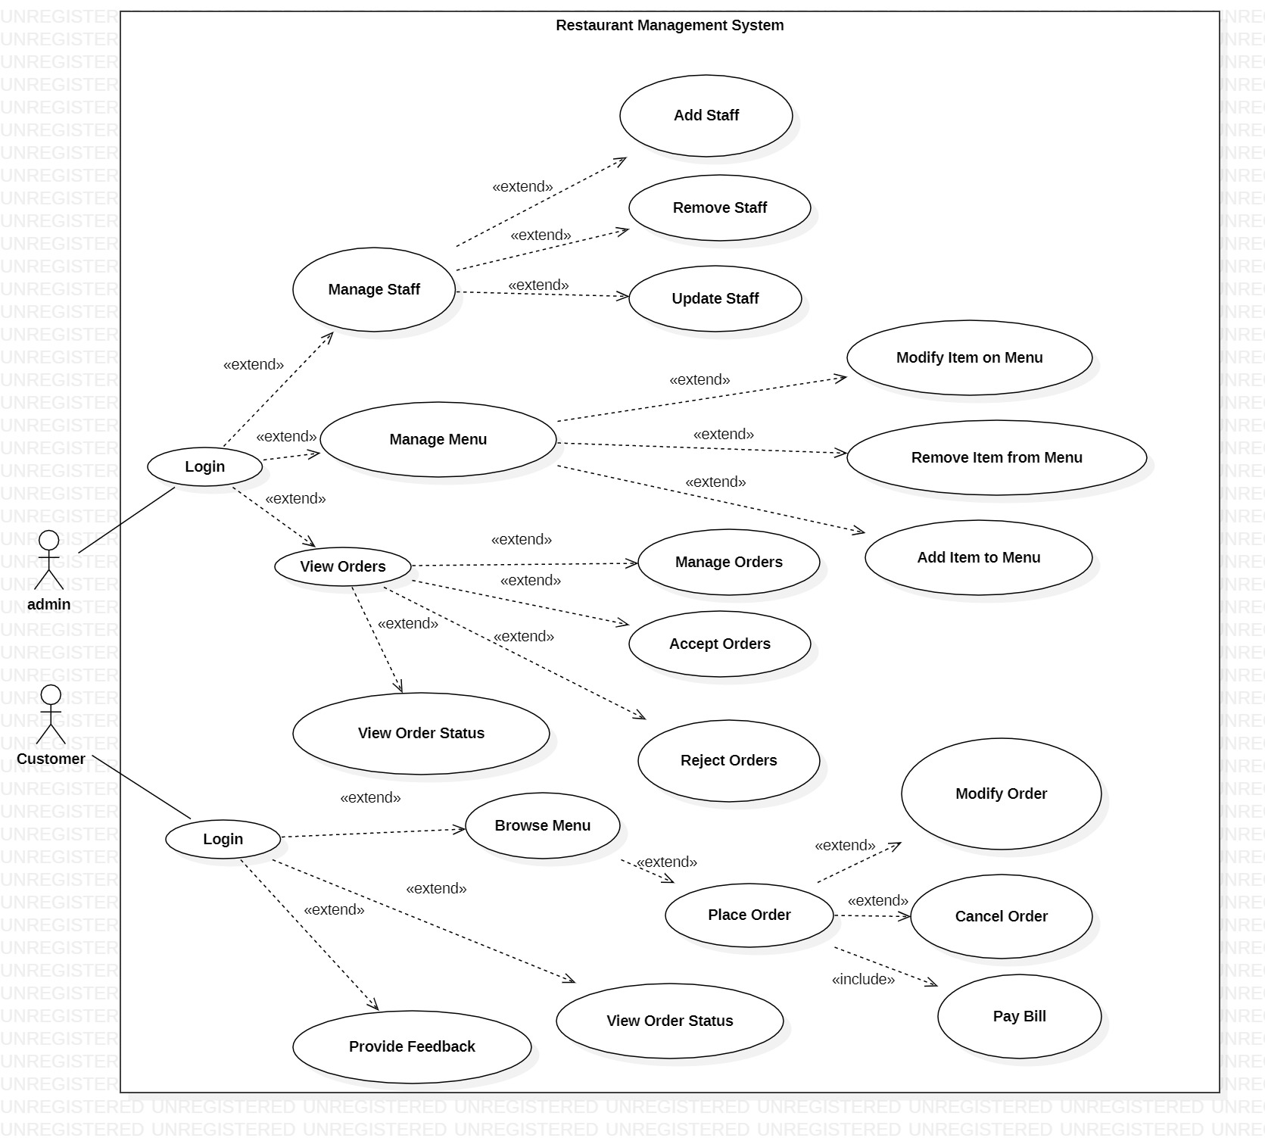
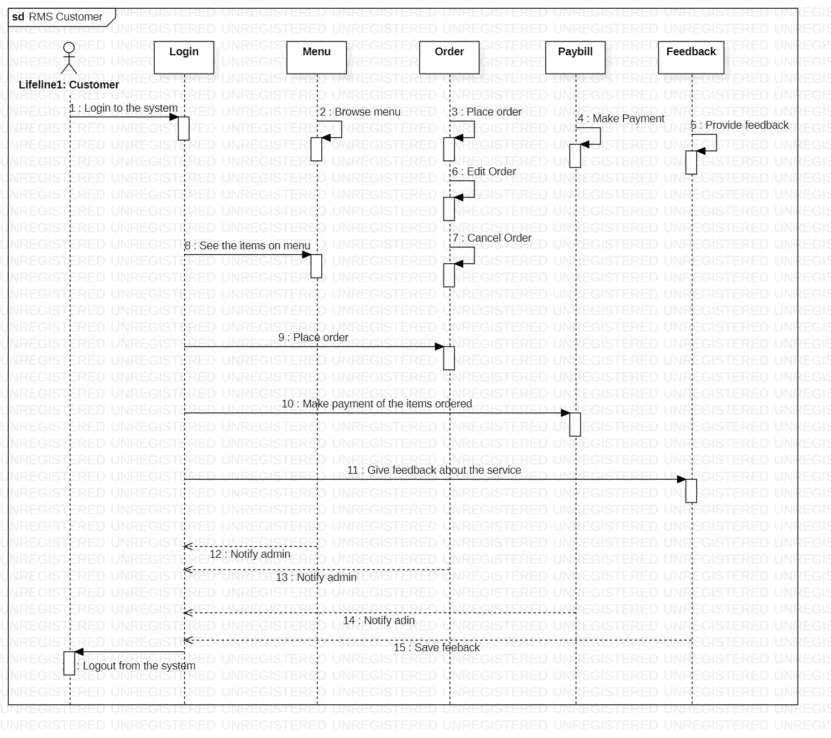
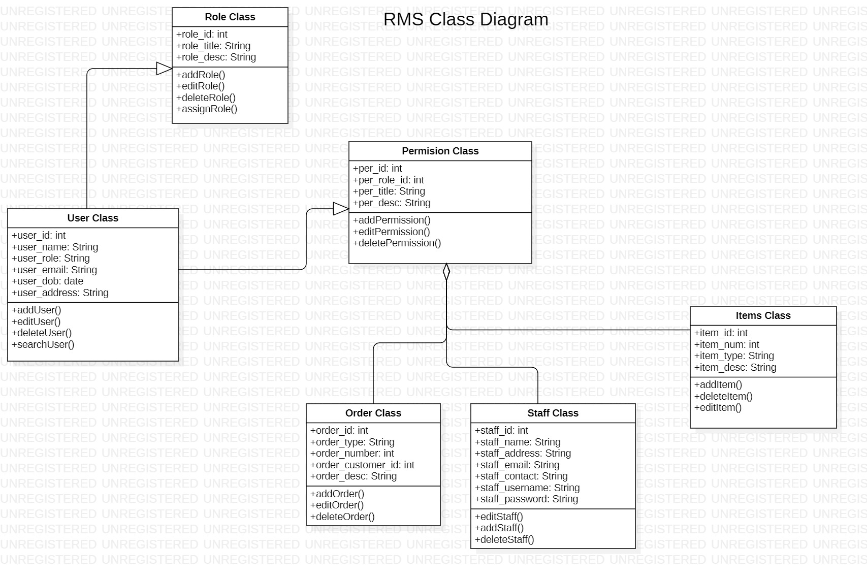
UML Diagrams
Use case :
Activity
Sequence
ERD
Class

Slide 11
Personal Development
New technologies learnt
Leveled up communication skills
More concern about deadlines
Good collaboration skills
More discipline

Slide 12
Developers
Developers - Who ?
Tasks and duties
Technologies selected
Challenges
Solutions
Accomplishment

Slide 13
Task and Duties
Convert requirements into code
1
Develop / create functional system
2
Follow BA instructions
3
Work on deadlines
4
Help each other
5
Talk about the issues and problem to the PM and BA
6

Slide 14
Technology chosen
Java – why ? More confident in java than in other languages
Git-Hub
Eclipse – IDE
Java Swing – Graphics
Basecamp

Slide 15
Challenges
Had a lot of bugs – needed to fix
Tutorial hell
IDE problems
Difficult to implement feature.

Slide 16
Solutions
Seek help from teachers and friends
Youtube tutorials
Chat GPT
Stack overflow
Meetings and idea sharing

Slide 17
Accomplishment
Successful login signup
Database connection
Staff management
Code – design

Slide 18
Benefits
More confident in Java
1
Fun working with friends
2
Real life project experience
3
Learnt about new technologies
4
Collaboration skills
5

Slide 19

Thank you

